Slide 1

Unemployment and Unemployment Benefits
Max Puhala, Russell McIntyre, Charise Teylor Nelson

Slide 2
Introduction
Currently, unemployment rates are the highest they have been since the 1930s.
Unemployed workers are entitled to benefits when dismissed from work through no fault of their own.
As state revenues decrease, unemployment benefits increase.

Slide 3
1. Using the US definition of unemployment, are you unemployed?
Why or why not?
People with jobs are employed.
People without jobs who are looking for jobs and available to work are unemployed.
People who aren’t employed or unemployed aren’t in the labor force.

Slide 4
2. How do the Federal and North Carolina governments cooperate in providing unemployment benefits to those out of work in North Carolina?
Each state administers a separate unemployment insurance program within guidelines established by Federal Law.
Eligibility is determined by state law.
States have unemployment benefits for 26 weeks.
During this time of high unemployment, the Federal government has passed emergency unemployment compensation programs.

Slide 5

Current Extension Programs in Effect
Emergency Unemployment Compensation of 2008 – Federal legislation providing up to 33 weeks of benefits
Federal Additional Compensation – Legislation providing an additional $25 supplement to weekly benefits
State Extended Benefits

Slide 6
3. Is it an economic cost when the state government taxes one citizen to provide unemployment benefits to another citizen? Why or why not?
For employed citizens, it is an economic cost since they are using their money to pay taxes benefiting others when they could be spending the money for themselves.
For unemployed citizens, it is an economic gain since they receive state-provided benefits.
From the state government’s perspective, unemployment benefits are economically neutral since the money remains in the economy.

Slide 7

4. Do unemployment benefits discourage individuals from looking for jobs? Why or why not?
Unemployment benefits certainly can discourage one from looking for a job due to moral hazard.
Moral hazard - The existence of disaster insurance leads to behavior that makes the disaster more likely.
Knowing that you’re insured for unemployment leads to a greater possibility of prolonged unemployment.

Slide 8
5. What impact has immigration had on unemployment during this recession?
It appears that immigration does not have a direct impact on unemployment during the recession.
Immigrants are consumers as well as producers.
In many different communities, immigrants are important in fostering growth and vitality in the local economy.

Slide 9
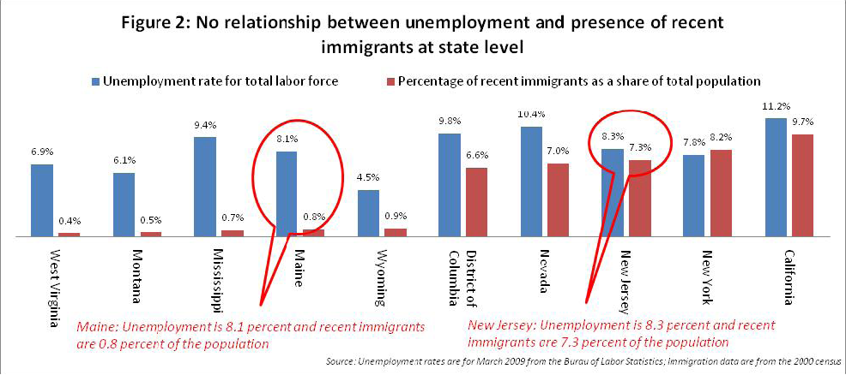

Slide 10
